Slide 1
SaVaNT - Prediction Guru
Adrian Wang

Slide 2
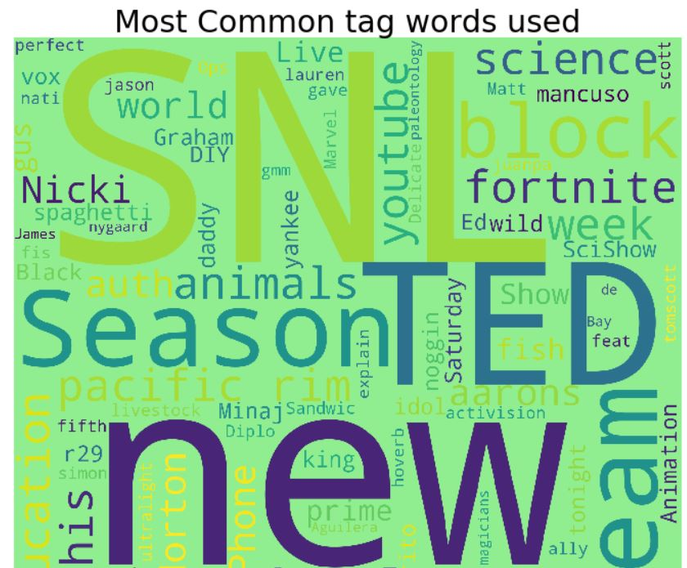
Overall Idea
Focus on US-based demographic to focus on a specific segment of audience: US Youtubers, # subscribers < 200k
Product: Web API with web app
What can it do?
Predict trending likelihood given tags, user info
Recommend tags the video should have to maximize popularity

Slide 3

Architectural Overview
Standard architecture for a web service
View represents the web app on client side
Controller and Model sit on the server side
User sends commands to Controller from web app

Slide 4
Implementation
Use WSGI (Web Server Gateway Interface) to intercept connection requests
Send request to Controller for prediction.
Send results as response to web app through WSGI
Controller holds collection of models, each prediction request uses specific model
Controller holds list of tasks to process sequentially

Slide 5
Extensions
WSGI concurrency
Define new requests
Parallel WSGI - Controller
WSGI as load balancer
Different models depending on context
Different views depending on user/tier

